Slide 1
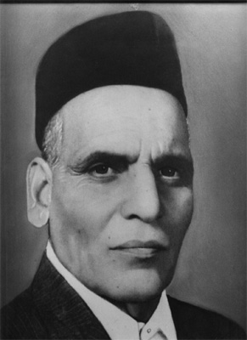
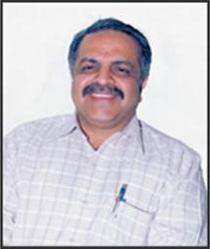
Welcome!
Administrative Office of Progressive Education Society’s
Modern College, Ganeshkhind – 411 016
Our Inspiration
Founder of Progressive Education Society Late Shri. Shankarrao Kanitkar
&
Honorable Chairman Dr. Gajanan Ekbote

Slide 2
Mission
Providing administrative and logistical support for the College’s curriculum, reinforcing its academic policies, maintaining the integrity of its institutional and educational records, and facilitating a culture that preserves the values of the College and its community.
To ensure quick & efficient response to student expectations
To adopt latest technology on a continuous basis.
To build pro-active, professional and involved work force in the office.
To enhance the staff members moral through best practices and corporate governance

Slide 3
Office Automation System
The college office is followed by office automation system (OAS) with the help of latest software's. Due to this it is possible for us to automate the process in college office. Using this system it is possible for us to keep data base of information like information of the students studying in various courses, employee information in various departments etc. Financial transactions are also stored and reports are maintained for future usage.
The college office is specifically designed taking into consideration student as a center point. The infrastructural facilities are developed for convenience of the students. Importance is given to the students & teaching staff of the college. Following are the highlights of the office:

Slide 4
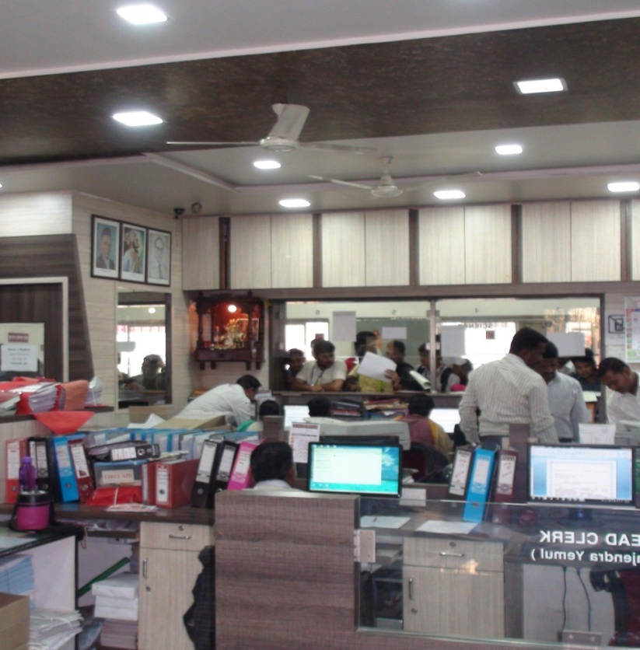
Highlights
E-Governance
Well designed and furnished office.
Computers with latest configuration.
LAN.
10MBPS WIFI Internet connectivity.
Latest all in one printers.
Portable Internet Modem.
Well trained, qualified and computer literate administrative staff.
Latest and advance software's.
Biometric Attendance System.

Slide 5
Administrative Structure
Principal
Vice Principal
Arts
Commerce
Superintendent
Head Clerk
Science
Senior Clerk [Accounts]
Senior Clerk [Admin]
Cashier
Accounts Assistant
Accounts Clerk [Payroll]
Junior Clerk [Arts]
Junior Clerk [Commerce]
Junior Clerk [Science]
Junior Clerk [Scholarship]
HOD
HOD
HOD
Asst. Professor
Asst.Professor
Asst.Professor

Slide 6
During 2nd and 3rd cycle of naac yearswise Graphical presentation of student strength

Slide 7
Courses Offered
Under Graduate Courses Post Graduate Courses
    B.Com M.Com
    BBA [CA] MCA Commerce
    B.Sc MA Economics
    B.Sc.Computer Science MA History
    B.Sc.Biotechnology MA Sociology
    B.Voc (Food Processing Technology) MCA Science
    B.Voc (Green House Technology ) M.Sc.Biotechnology
    BA M.Sc.Microbiology
    B.Sc. Animation M.Sc. Chemistry
    B.Sc. Nano Technology M.Sc.Zoology
    BCA Science M.Sc.Computer Science

Slide 8
Teaching & Non Teaching Staff
Sr.No. | Particulars | Nos.
1 | Teaching Staff | 138
2 | Administrative Staff | 21
3 | Laboratory Staff | 51
 | Total Staff | 210

Slide 9
Last Five Years Gender wise Student Data
Year | Male | Female | Total
2011-12 | 2160 | 1909 | 4069
2012-13 | 2068 | 2025 | 4093
2013-14 | 2098 | 1980 | 4078
2014-15 | 2364 | 2121 | 4485
2015-16 | 2124 | 2196 | 4319
2016-17 | 2262 | 2360 | 4622

Slide 10
Last Five Years Category wise Student Data
Year 2000 | Open | SC | ST | NT-A | NT-B | NT-C | NT-D | OBC | SBC | Min | Total
11-12 | 2369 | 603 | 112 | 99 | 62 | 71 | 20 | 648 | 49 | 36 | 4069
12-13 | 2213 | 586 | 137 | 86 | 89 | 74 | 30 | 655 | 45 | 178 | 4093
13-14 | 2326 | 565 | 133 | 85 | 73 | 84 | 32 | 639 | 52 | 89 | 4078
14-15 | 2358 | 683 | 179 | 82 | 71 | 117 | 63 | 716 | 60 | 156 | 4485
15-16 | 2327 | 725 | 219 | 75 | 95 | 131 | 30 | 598 | 57 | 63 | 4320
16-17 | 2440 | 773 | 159 | 102 | 85 | 141 | 58 | 670 | 52 | 142 | 4622

Slide 11
Graphical Presentation of Cast Category wise student details for the year 2015-16

Slide 12
Last Five Years Financial Position
Year | Receipts | Expenditure | Surplus/ Deficit | Additions to Assets | Investment Made
2011-12 | 98239521 | 86879872 | 11359649 | 6815171 | 34250000
2012-13 | 103990894 | 89599930 | 14390964 | 6973267 | 40500000
2013-14 | 71309550 | 55959699 | 15349850 | 5067718 | 44500000
2014-15 | 70676932 | 65479400 | 5197531 | 9214580 | 32500000
2015-16 | 67169677 | 71715480 | -454803 | 12067299 | 26260000

Slide 13
Graphical Presentation of Income & Expenditure Account

Slide 14
Office Infrastructure
Sr. No. | Particulars | Specifications | Nos
 | Office Equipments
1 | Computers | Core i3 Asus Motherboard, Intel Processor, 4GB RAM, 500GB HDD, DVD Writer, DEL 19.5’ LED Screen, Logitech Keyboard, Mouse. | 17
2 | Laptops | Dual Core 2GB RAM, 15.5’ Screen 2Nos Del Inspron15 , Intel Core i3. Processor Intel, 4GB RAM, 1TB Hard Disk 2 No. | 4
3 | Scan, Copy Machine | 1-Konica Minolta, Canon IR3225 | 2
4 | Portable Internet Modem |  | 3
5 | 10MBPS Internet Connectivity System | AIRCEL WIFI | 1
6 | 32 Channel Digital Surveillance System | CCTV, DVR with USB 3TB HDD for backup. | 1
7 | Printer | Image class Canon All in One 2 Image Class 4412 All in One 1 Image Class MF 3010 All in One 1 Canon LBP 2900 1 Colour HP CP 1025 1 Other 1 | 7
8 | WIFI Device | Netgear WIFI Router | 1
9 | Digital Locker for Cash | Godrej | 2

Slide 15
SOFTWARE USED
 | Software
1 | Vruddhi for Students Record | Multiuser | 1
2 | E-tax -Hyderabad | For filing of Income Tax Returns | 1
3 | Tally ERP09 | Multiuser for Accounts | 1
4 | Shree Lipi | For Marathi Typing | 1
5 | Akruti | For Marathi Typing | 1
6 | Biometric Attendance System | For Staff Attendance | 1
7 | Samajkalyan e-scholarship | For Scholarships | 1
8 | Profession Tax Online | For Payment of Profession Tax and Monthly returns. | 1
9 | Vetan Pranali | For Grantable Payroll System | 1

Slide 16
Details of scholarships and freeships received and paid to the students during the year 2011-12 to 2015-16
YEAR | RECEIPTS | PAYMENTS
2011-12 | 3581932 | 3567724
2012-13 | 3896295 | 3875031
2013-14 | 3385490 | 2462396
2014-15 | 6169503 | 7498710
2015-16 | 11816754 | 11584581

Slide 17
Administrative staff profile
Sr. No. | Name | Designation | Qualification
1 | Ganesh Sathe | Superintendent | M.Com., DCA, MSCIT,
2 | Rajendra Yemul | Head Clerk | B.Com, MS.office
3 | Bharati Bhosale | Senior Clerk | MA,MSCIT,DIT
4 | Sunanda Masalkar | Senior Clerk | B.Com., MSCIT
5 | Shivaji Sonawane | Junior Clerk | M.A.B.Ed., MSCIT
6 | Nitin Kakade | Junior Clerk | B.A.MSCIT,DCA
7 | Mangesh Nalawade | Junior Clerk | B.Com., Ms.Office
8 | Mahesh Bandal | Junior Clerk | BA., MSCIT
9 | Smita Kadam | Junior Clerk | B.Com.
10 | Nutan Waghmare | Junior Cerk | MA
11 | Amrut Kadam | Junior Clerk | B.Com.
12 | Shubhangi Navale | Junior Clerk | B.Sc.
13 | Prerana Nevase | Junior Clerk | BCA ,DIT
14 | Shivangi Kengar | Junior Clerk | B.Com

Slide 18
Library Administration Staff
1 | Sangita Dhamdhere | Librarian | M.Lib.I.Sc.,NET/SET,ADCSSAA, Ph.D. Honrs.
2 | Sheetal Shetty | Library Clerk | M.Com.,DIT,MSCIT,LTC, B.Lib.
3 | Madhav Deshpande | Lib. Attendant | 9th Pass
4 | Makarand Shendkar | Lib. Attendant | BA,MSCIT, B. Lib.
5 | Mohol Santosh | Lib. Attendant | BA,MSCIT,
6 | Vidya Sudar | Lab.Attendant | B.Sc., B. Lib
7 | Khude Raju | Lib. Attendant | SSC Fail

Slide 19
Laboratory Staff
1 | Kashiram Kadam | Lab. Asst. | M.A., DIT, Ms-CIT
2 | Trupti Kulkarni | Lab. Asst. | B.Sc.
3 | Raju Gagada | Lab. Att. | B.Sc.
4 | Nilesh Waghmare | Lab . Att. | B.A.
5 | Chardutta Late | Lab. Att. | M.A.
6 | Satish Dodke | Lab. Att. | M.A.
7 | Sunil Karote | Lab. Att. | H.S.C., MS-CIT
8 | Sandeep Erewad | Lab . Att. | B.A., MS-CIT
9 | Raju Jadhav | Lab. Att. | S.S.C.
10 | Sachin Kaldhonkar | Lab . Att. | H.S.C

Slide 20
Laboratory Staff
11 | Kumar Bahirat | Lab. Att. | S.S.C. Fail
12 | Sachin Gaikwad | Lab . Att. | S.S.C.
13 | Vitthal Pujari | Lab. Att. | S.S.C.
14 | Rajendra Borade | Lab. Att. | H.S.C.
15 | Navnath Shelke | Lab. Att. | H.S.C.
16 | Vikas Jadhav | Lab . Att. | H.S.C., MS-CIT
17 | Prakash Patole | Lab. Att. | H.S.C.
18 | Sandeep Bahirat | Lab . Att. | H.S.C.
19 | Damodar Kolekar | Lab. Att. | S.S.C.

Slide 21
PEON
1 | Hagawane Rajkumar | S.S.C. Fail
2 | Joshi Prakash | 9th Fail
3 | Kanti Prasad | 5th Fail
4 | Jadhav Baban | 7th Pass
5 | Zite Vishal | S.S.C. , MS-CIT
6 | Gaikwad Sachin | S.S.C.
7 | Shinde Pandurang | S.S.C. Fail
8 | Sanjay Jadhav | S.S.C.
9 | Joshi Sushant | 7th
10 | Smt. Swati Shibe | 8th Pass

Slide 22
PEON
11 | Anup Ghume | S.S.C.
12 | Amol Korhalkar | H.S.C., IIT
13 | Ashish Shindekar | S.S.C.
14 | Rakesh More | S.Y. B.Sc, MS-CIT
15 | Ashok Sutar | S.S.C.
16 | Rushikesh Shedge

Slide 23

Office premises
Notes:
Office Premises

Slide 24
Staff is encouraged for getting higher qualification. FOLLOWING IS THE LIST OF ADMINISTRATIVE STAFF THOSE HAVE EXTENDED THEIR QUALIFICATION DURING LAST FIVE YEAR.
SR.NO. | NAME | DESIGNATION | BASIC QUALIFICATION | QUALIFICATION
1 | Mrs. Newase Prerana | Jr.Clerk | BCA | Appeared for MCA
2 | Ms. Kengar Shivangi | Jr.Clerk | B.COM | Appeared for M.Com.
3 | Mr.Late Charudatta | Lab.Att. | HSC | M.A.
4 | Mr. Mohal Santosh | Lib.Att | BA | BA M.LIB.
5 | Mrs. Shetty Sheetal | Lib.Clerk | M.COM | M.COM, M.LIB
6 | Mr. Shendkar Makarand | Lib.Att. | BA | BA, M.LIB
7 | Mr.Dodke Satish | Lab.Att. | HSC | MA
8 | Mr.Erewad Sandeep | Lab.Att. | HSC | MA
9 | Mr.Darekar Mahesh | Lib.Att. | B.COM | B.Com. M.Lib.

Slide 25
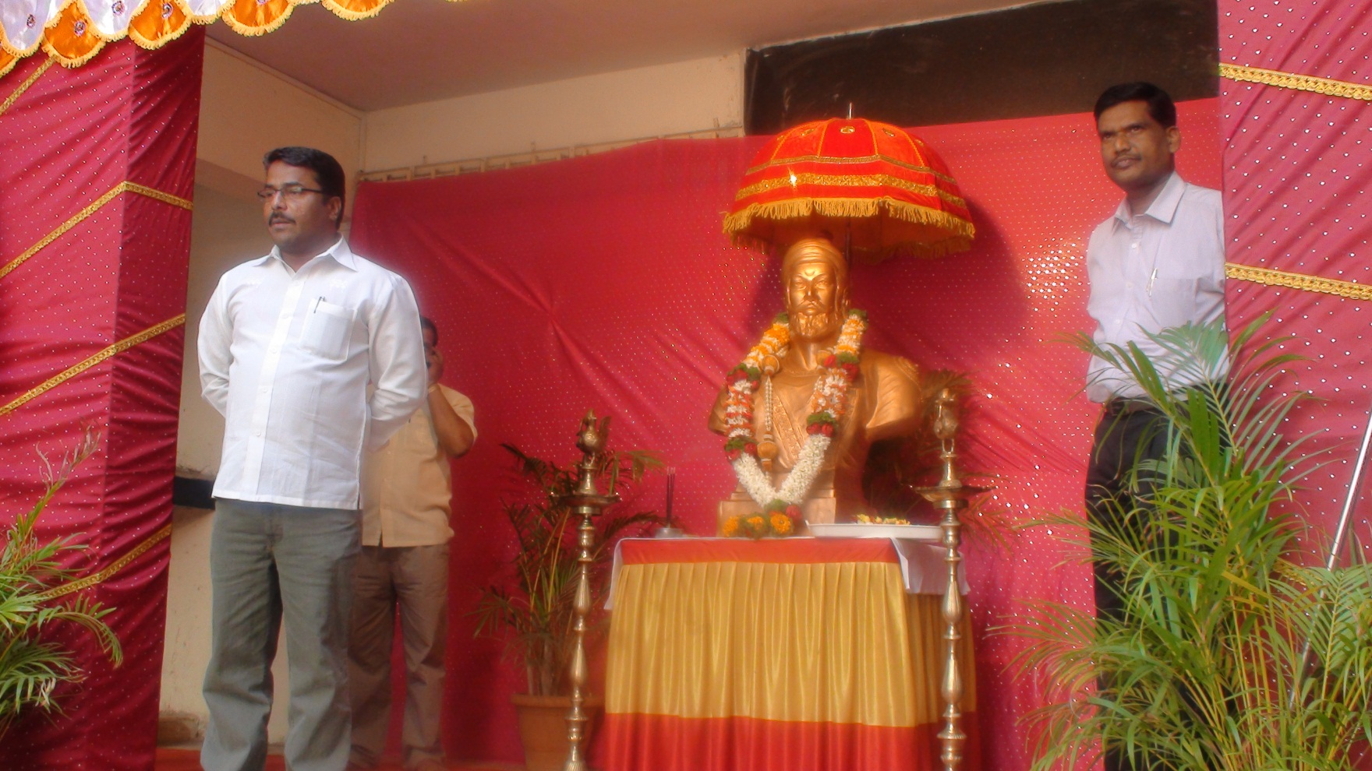
Chhatrapati Shivajimaharaj jayanti

Slide 26
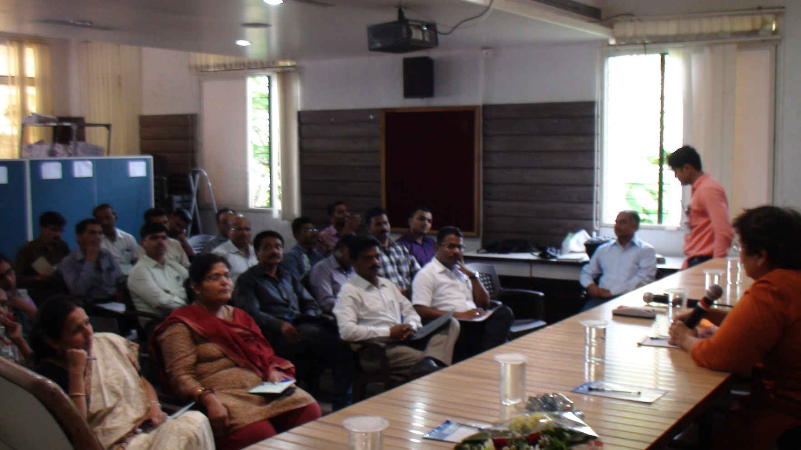
training programme was arranged for the capacity building for the administrative staff of the college. through rambhau mhalgi pratishthan pune.

Slide 27
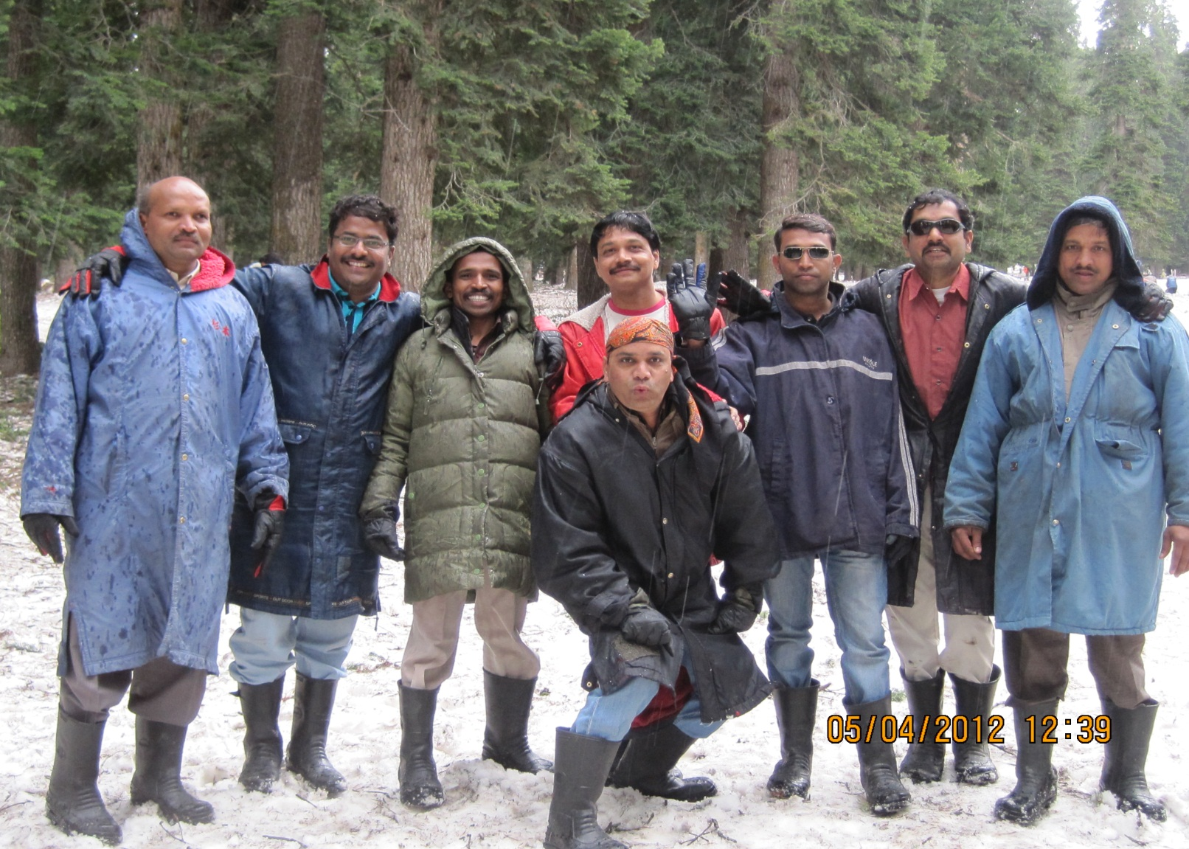
Kashmir tour for office staff

Slide 28
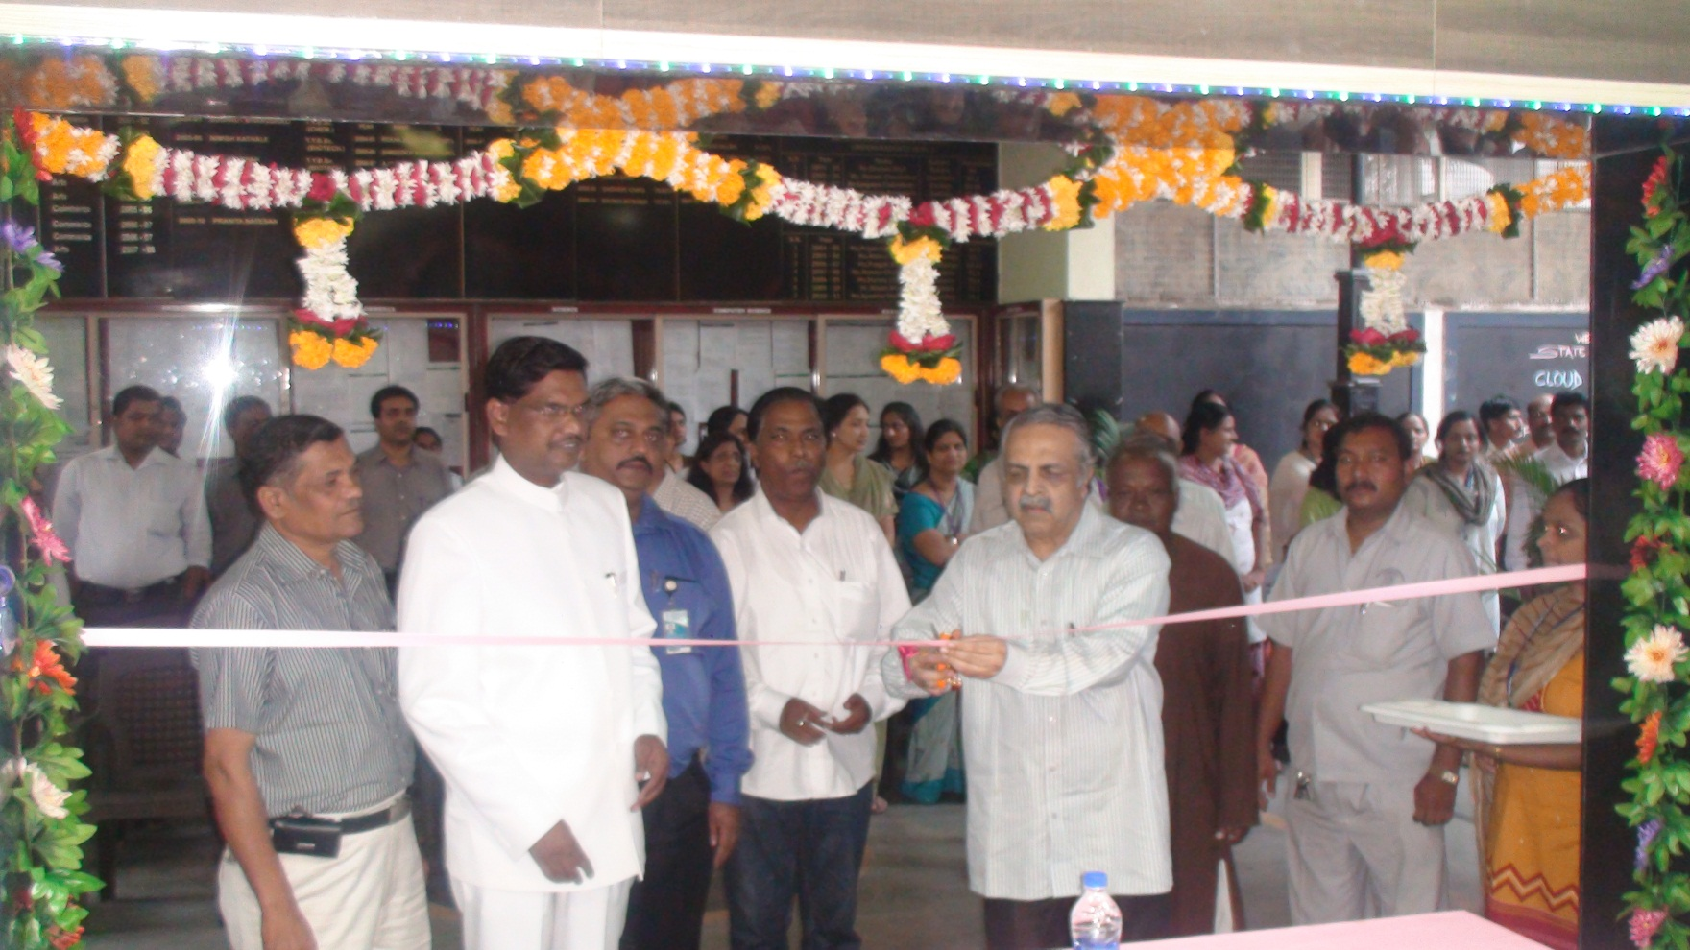
Office inauguration in the hands of hon’ble dr. g. r. ekbote in the presence of prof. s. s. deshmukh, prof. dixit, prof. todkar & prin. Dr. sanjay kharat on 7th oct 2013

Slide 29
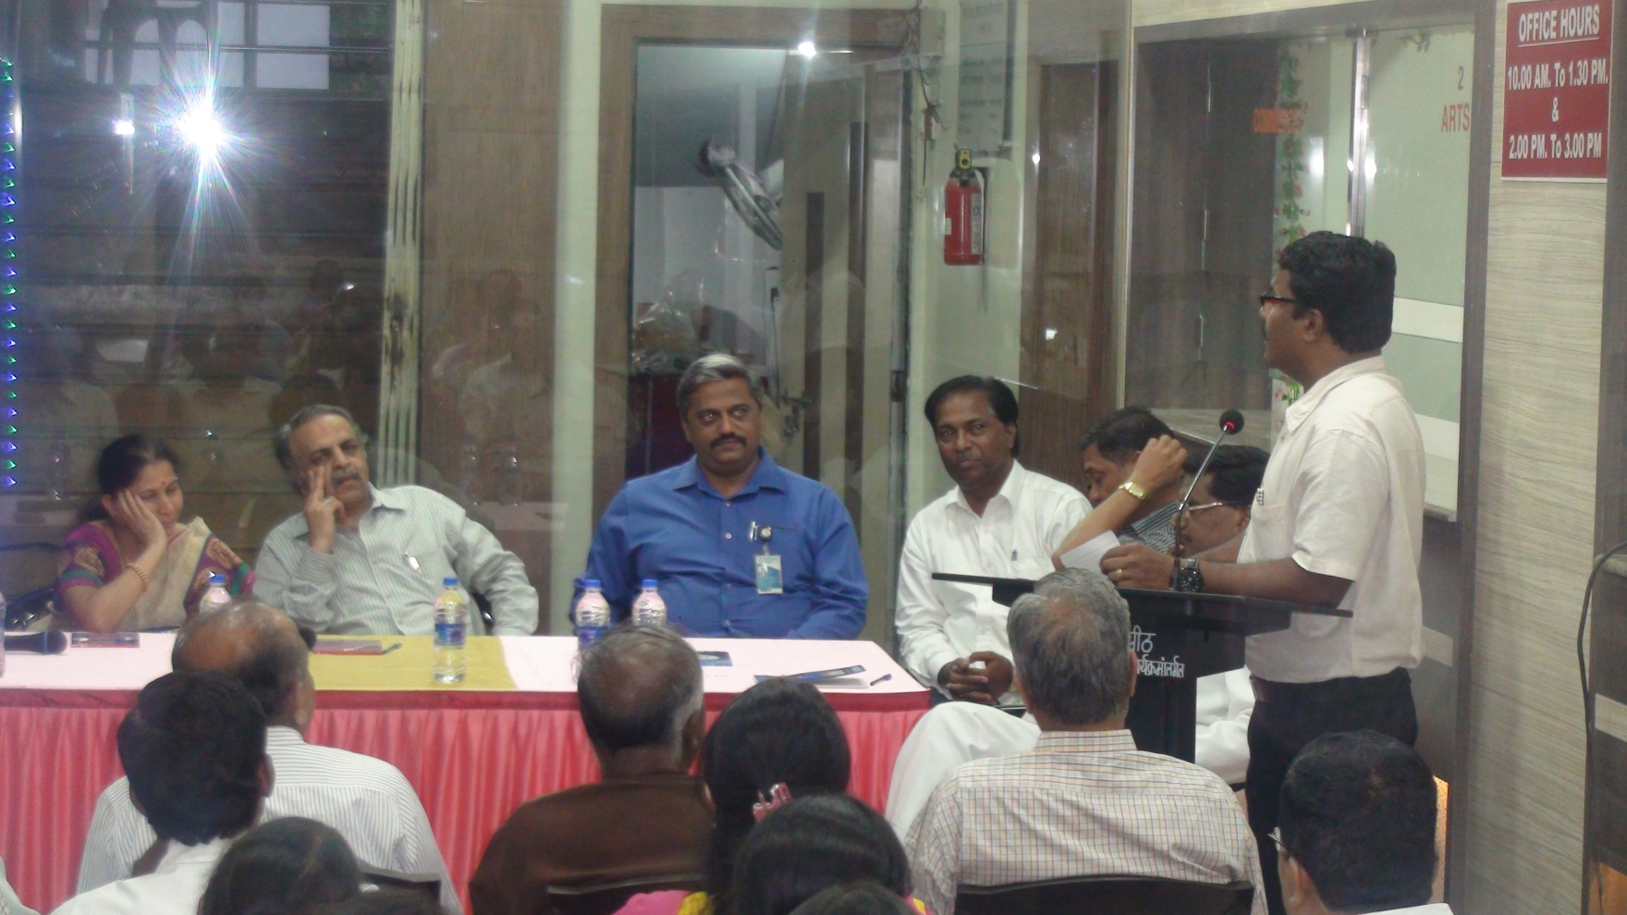
New office inauguration program

Slide 30
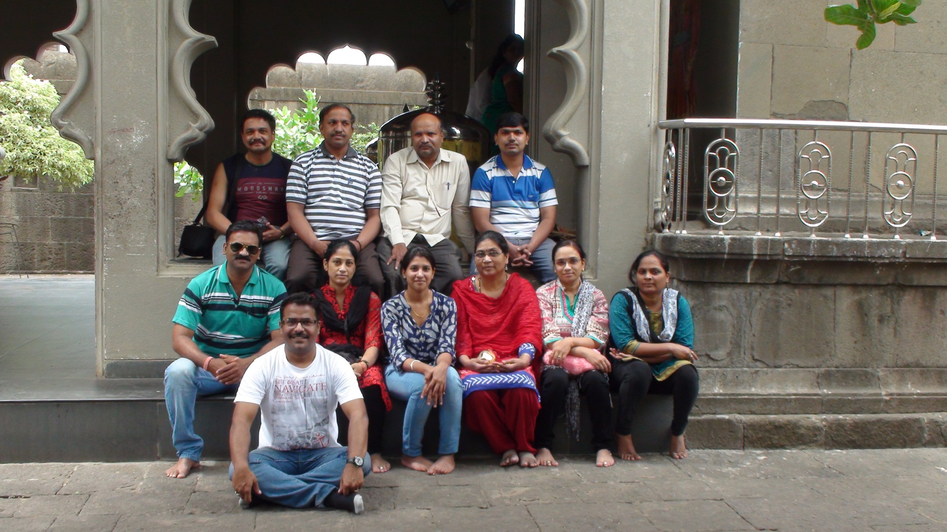
Office tour to holy place ozar & shivanery fort birth place of chatrapati shivajimaharaj was arranged for the recreation of the staff.

Slide 31
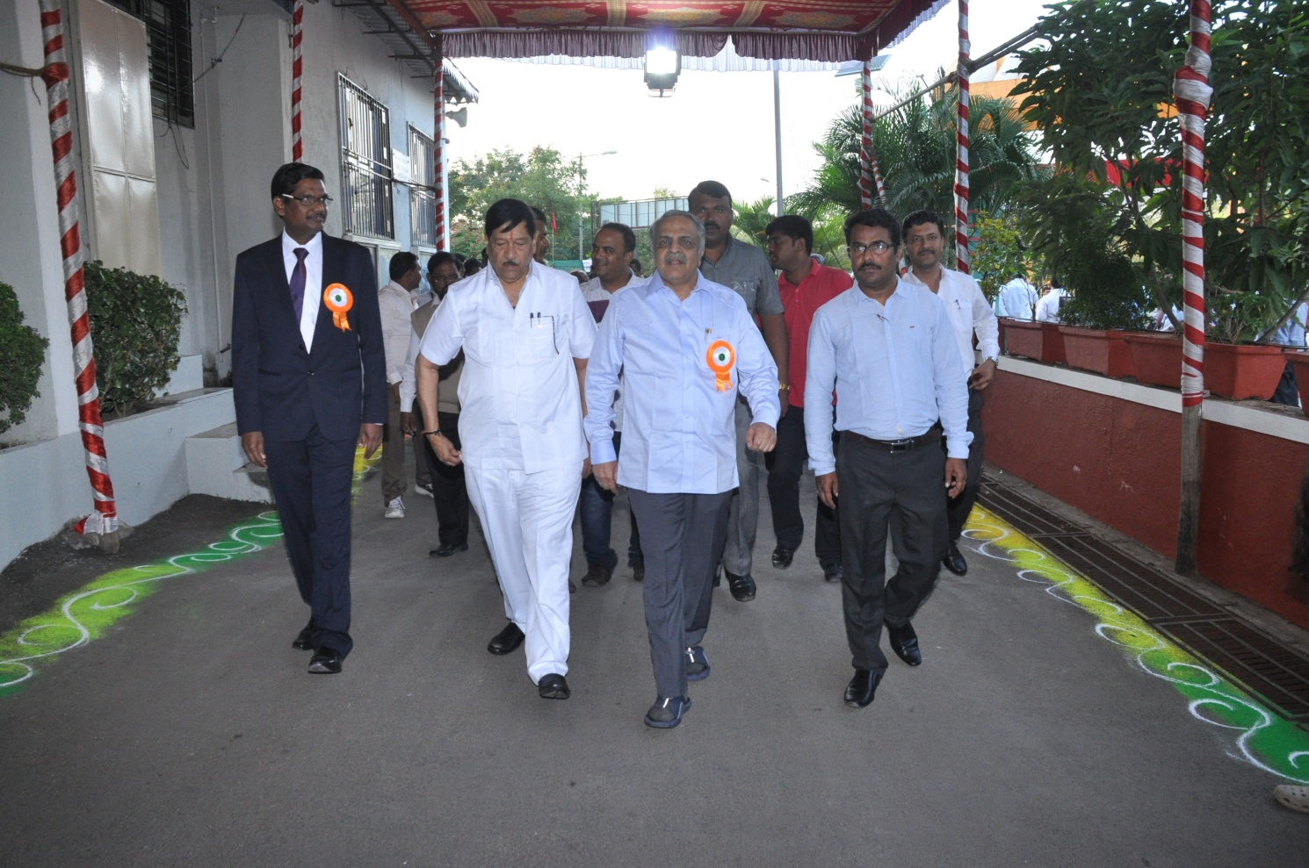
Solar wind hybrid energy plant inauguration 2015

Slide 32
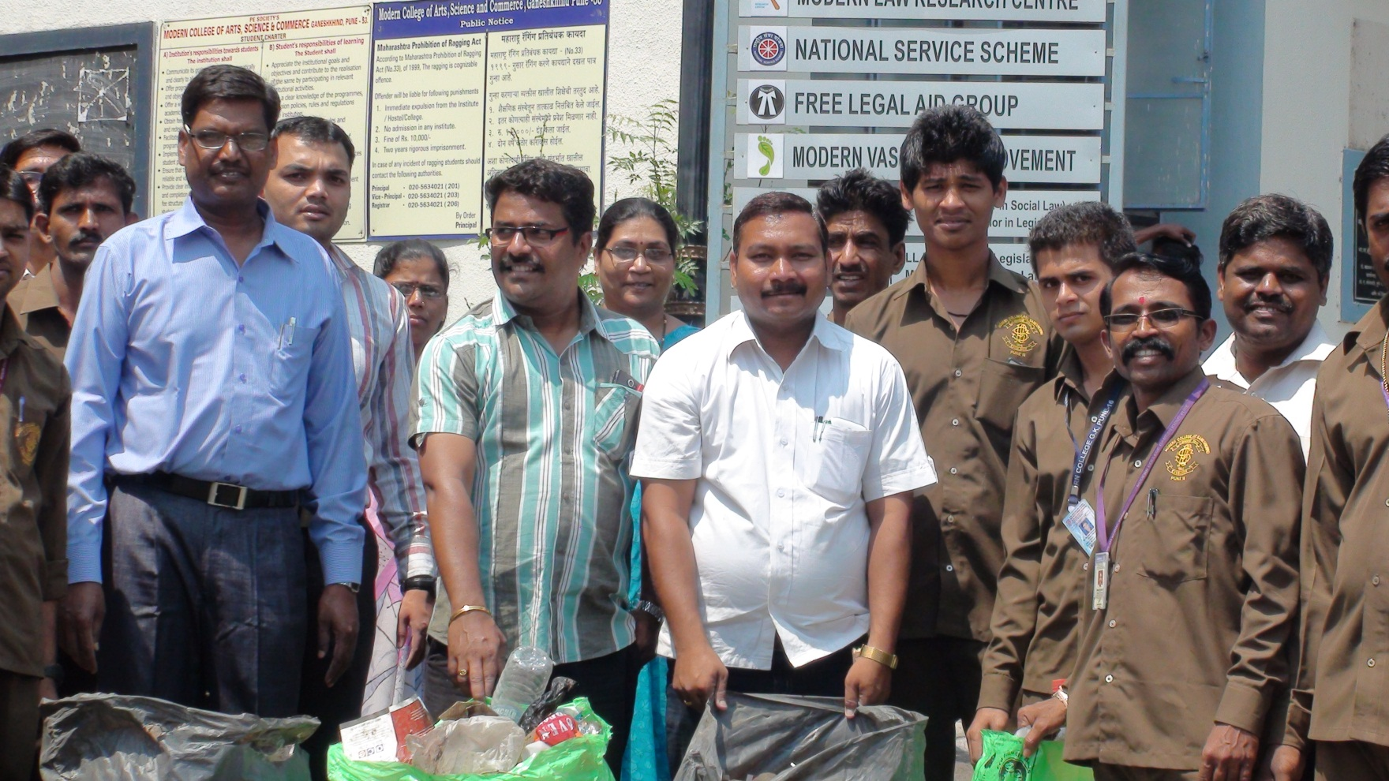
Vasundhara day 2014 college campus was cleaned by all non teaching staff of the college

Slide 33
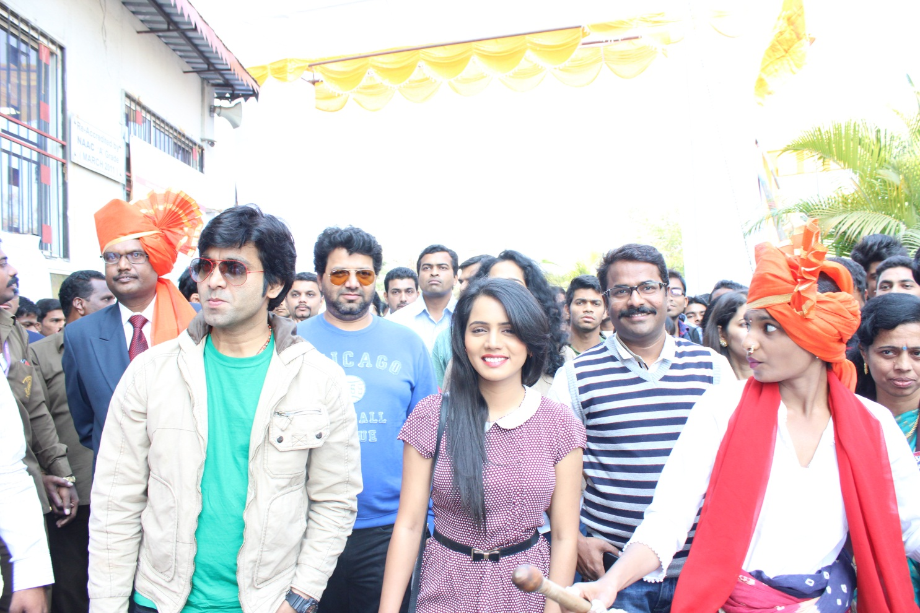
Administrative staff was also actively involved in the student activity Vividha college allumina students program to encourage enterpreneiourship among the students in the year 2013-14

Slide 34
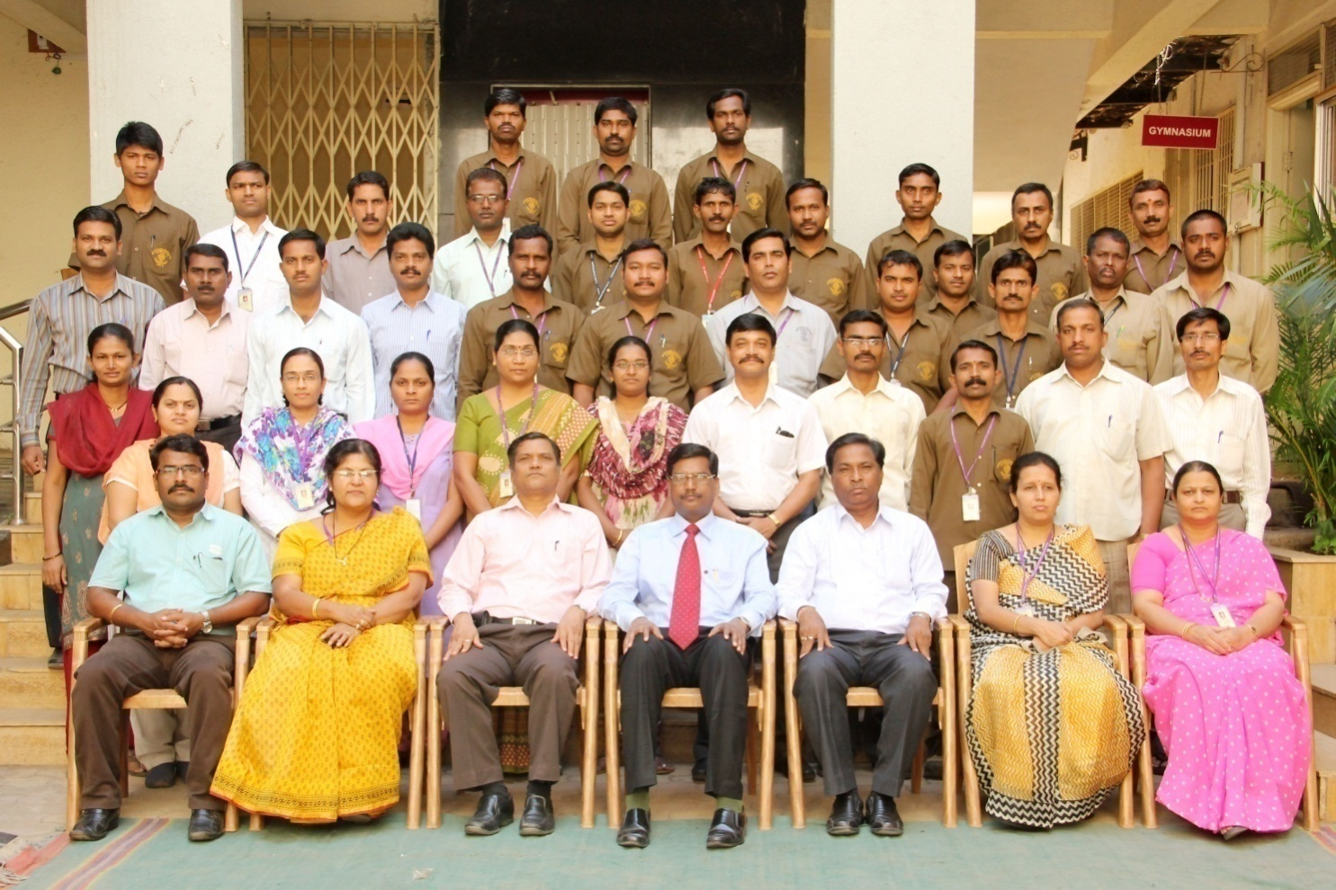
Administrative staff group photo

Slide 35
We are very much thankful to Our hon’ble chairman dr. g.r. ekbote, lmc chairman prof. suresh todkar , visitor prof.dr. p.g. dixit and mostly our principal dr.sanjay kharat , all teaching & administrative staff for their valuable gudance and continious support thanks
Ganesh Sathe
Registrar

